Slide 1
Data Science Project in Python
Group -17
Pooja Mahadeshwar 15
Manohar Jha 16
Raj Rege 21
Tanay Ruparelia 31

Slide 2
Project Summary
Aim of the Project
Dataset Information
Reason for choosing the dataset
Insights from Analysis
Descriptive Analytics on Data
Building a ML model using Logistic Regression.
Conclusion
Future Scope

Slide 3
Aim of the Project
To create a ML model using python which can ascertain whether the loan shall be approved or not taking all possible factors into consideration.

Slide 4
Dataset Information
Taken from Kaggle, last updated in 2018
A Bank wants to automate the loan eligibility process (real time) based on customer detail provided while filling online application form.
These details are Gender, Marital Status, Education, Number of Dependents, Income, Loan Amount, Credit History and others.
The data has 615 rows and 13 columns.

Slide 5
Reason for choosing the dataset
As the data set is from BFSI sector, we were inclined towards it as being from the commerce background.
To understand how the different categorical factors play role in the decision making of rejection or acceptance in approval of the loan.
Many a times, the customer expects the loan to be approved but doesn’t get it, resulting in the loss of time and energy, which can be prevented if such real time Machine Learning model will be available.

Slide 6
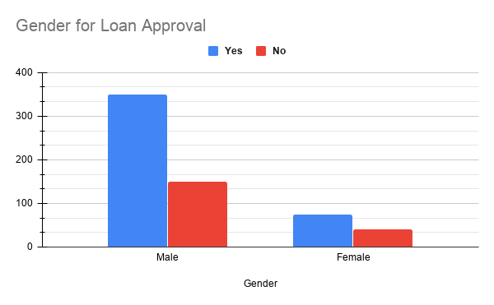
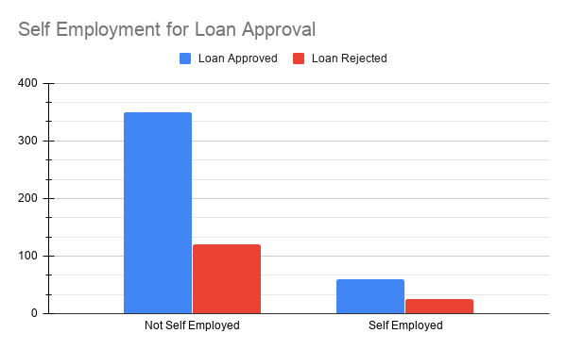
Insights from Analysis
350 male customers have been approved for the loan, whereas only 150 female have been approved for the same. And there are 75 male who did not get approval for the loan and around 80 females have not been approved with loan.
There are 350 customers who are not self employed and have received the loan, also 60 employed customers have received loan status. There are 175 customers who are not self employed and have not received loan along with 25 self employed customers did not receive loan status

Slide 7
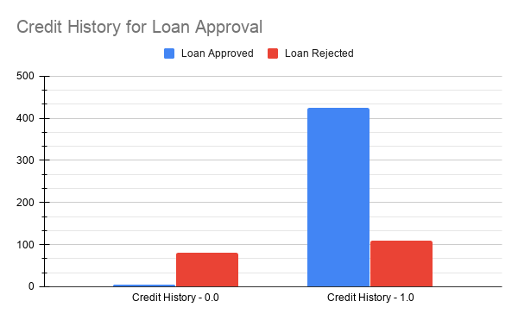
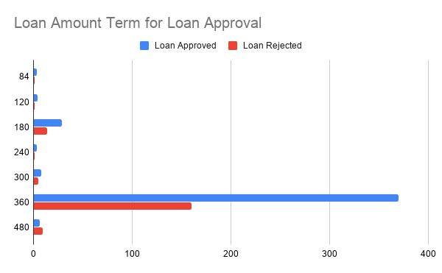
There are approximately 5 customers who have not provided credit rating, and have still received loan, whereas 80 people have received the loan even though they haven't provided any credit rating. 425 customers have provided their Credit history and have also received loans, whereas 110 customers, who have provided their credit ratings have not received the loan.
This is the loan amount term description at 84 days, 120 days , 180 days, 240 days, 300 days, 360 days and 480 days.The graph shows how many customers have received loans appeoved or unapproved from the term period at different time interval from bank.

Slide 8
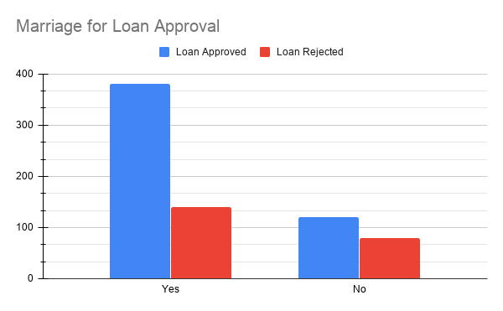
There are 380 married customers who have received loan and 140 unmarried customers did not receive loan. Whereas there are 120 married customers who received loan and 80 unmarried customers who did not receive any loan.

Slide 9
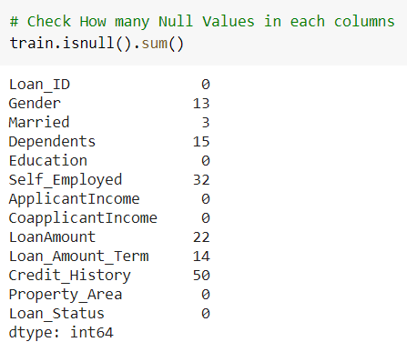
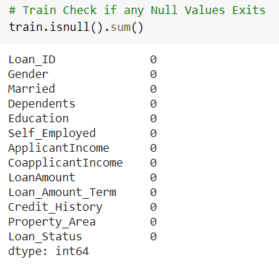
Building a ML model using Logistic Regression
Pre-processing
Handling missing values

Slide 10
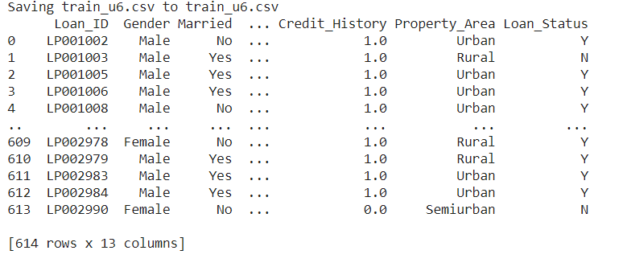
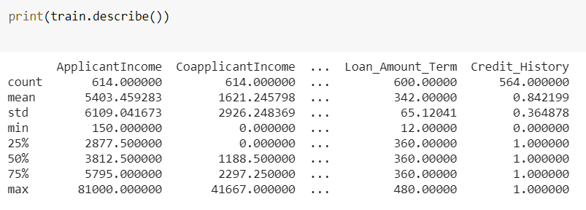
Descriptive Analytics on Data
Display of data
Description of data
print(train.describe())

Slide 11
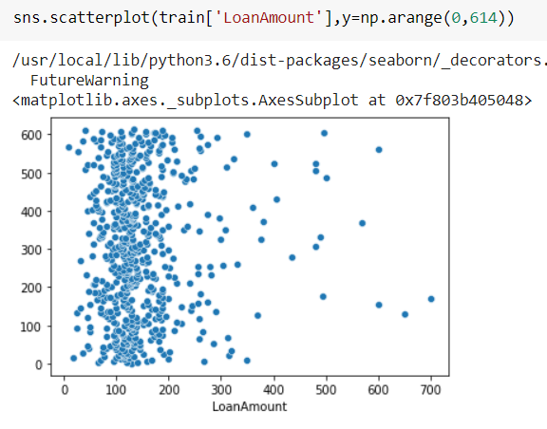
Plotting Outlier
Scatter plot is used to identify the outliers in the dataset.

Slide 12
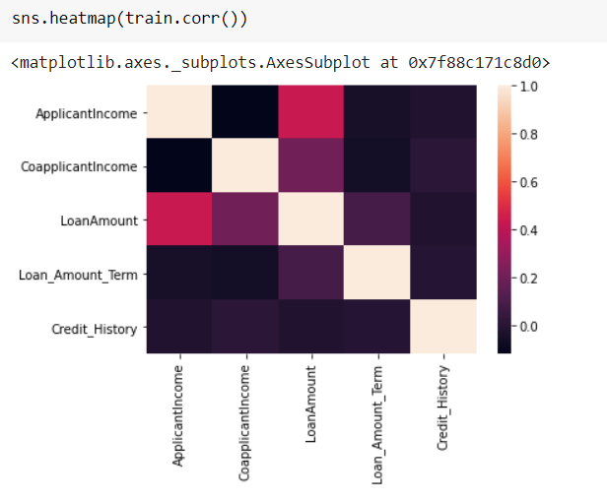
Heatmap - Correlation
Heatmap used to find the correlation between the given columns

Slide 13
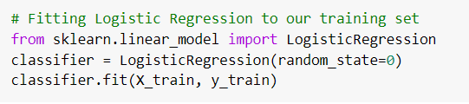
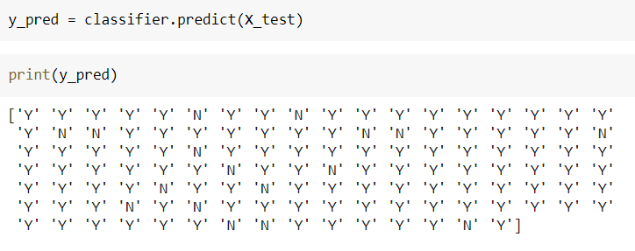
Logistic Regression Model

Slide 14
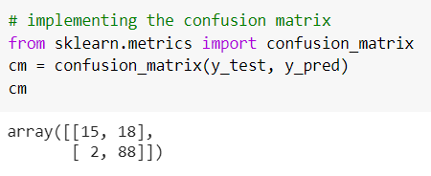
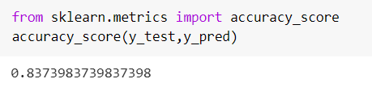
Confusion Matrix & Accuracy

Slide 15
Conclusion
An ML model has been devised using the logistic regression model with an accuracy of 84%, thus it can be used to identify the right prospects for the Bank.
Will decrease the loan approval time as it’s based on proper research of the clients financials, and will increase the customer satisfaction

Slide 16
Future Scope
By using hyperparameter tuning accuracy can be increased.
Using deep learning, the prediction accuracy can be increased.
Helps to find credible customers.
Can help in preventing frauds by eliminating the non-eligible customers

Slide 17
Thank you

